Slide 1
Capstone Presentation
Mahindra First Choice Services, Case Study
Presented by:
Prerna Singhal
Gonzalo Sosa
October, 2019

Slide 2
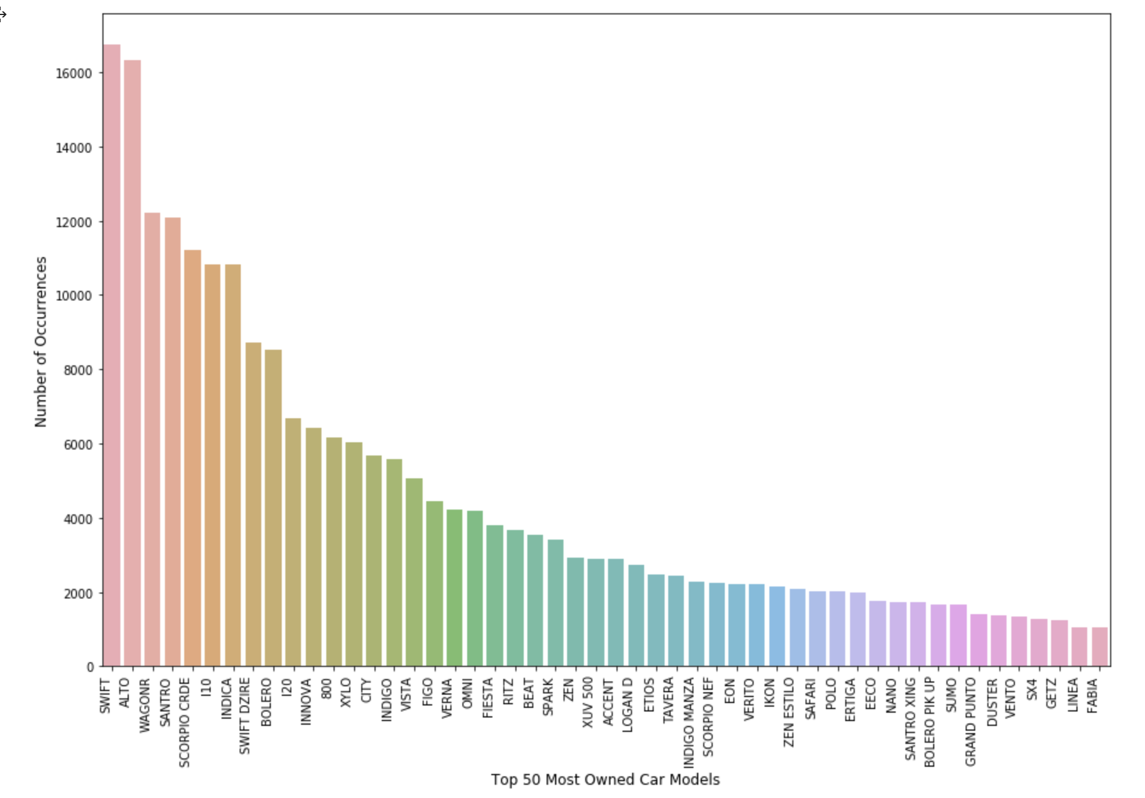
Problem Statement 1 - Ownership and Spending patterns Overview
This chart depicts the top 50 most owned car models throughout the country.
Pattern suggested that economy priced hatchbacks are the most selling models and value conscious customers.
We have analysed lowest owned models. Some of them include: A-star, pushpak, Eco-sport, tata nano, TT, Z4 and Estilo.
Notes:
Can we include some examples here?

Slide 3
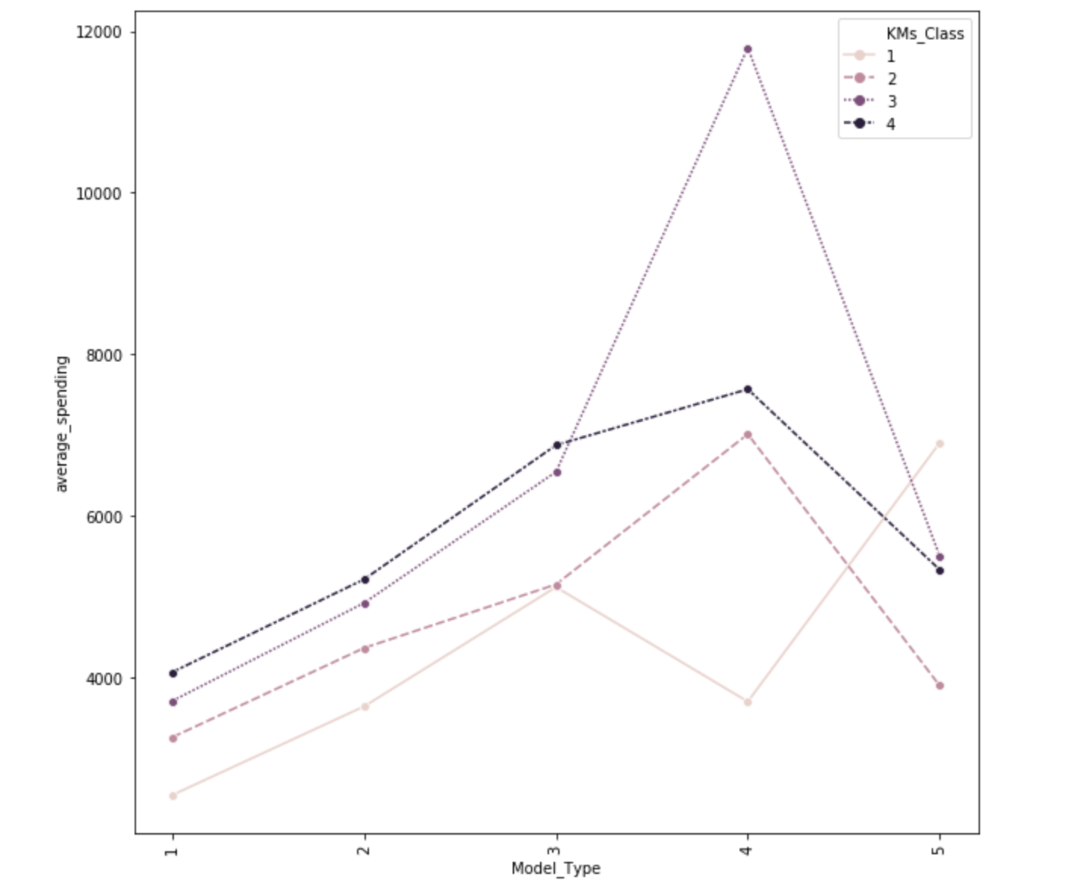
Model type and Car age visualisation
We have divided the dataset into model types which is the type of the car [1: Hatchback, 2: Sedan, 3: XUV, 4: Luxury, 5: Utility Vehicles]. Also we have classified cars as per their age on the basis average mileage [1: 1year, 2: 2-3 year, 3: 4-5 year, 4: >5 year]
The graph suggests the average spending on a particular car type as per its age.
As seen in the graph, after completing 3 years average spending on a luxury car shoots up tremendously as compared to other car types.
Notes:
Can we include some examples here?

Slide 4
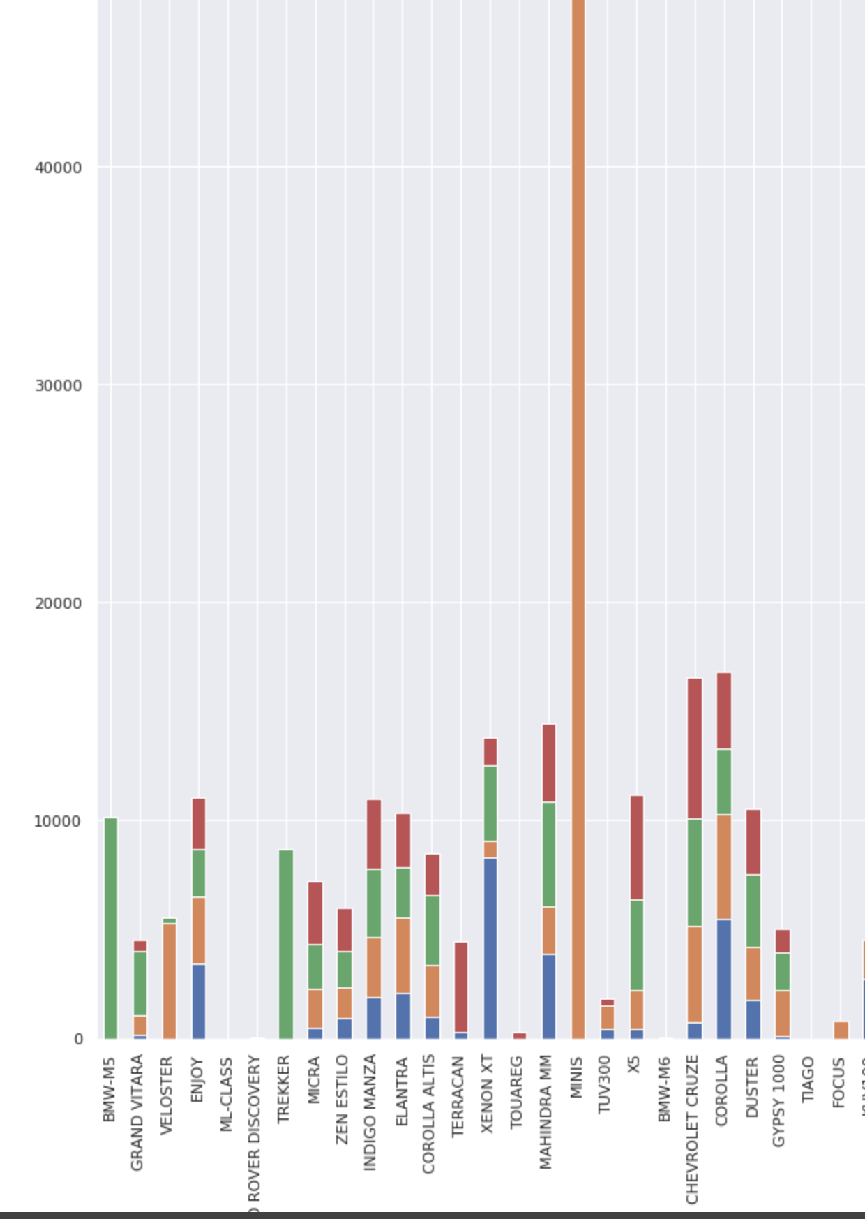
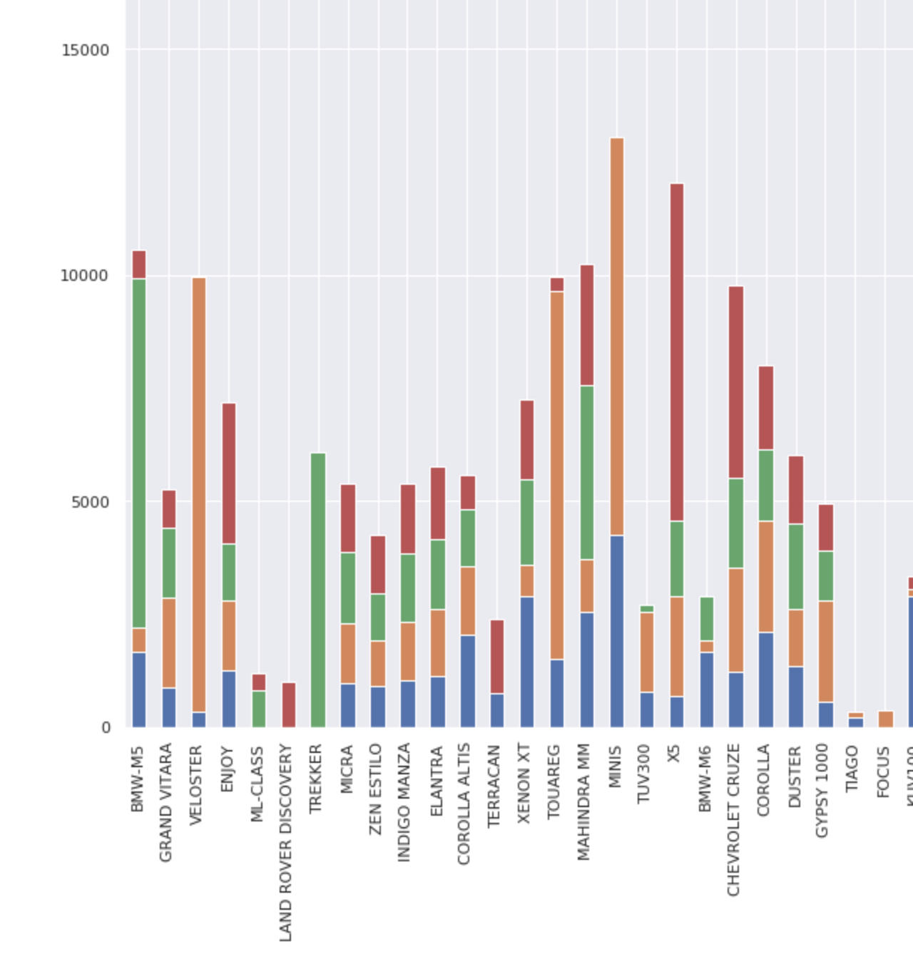
Average Labour and Parts Spending
Average parts Spending by model as per mileage cluster
These graphs depicts the average labour spending and average parts spending on some of the models.
Average labour Spending by model as per mileage cluster
Notes:
Can we include some examples here?

Slide 5
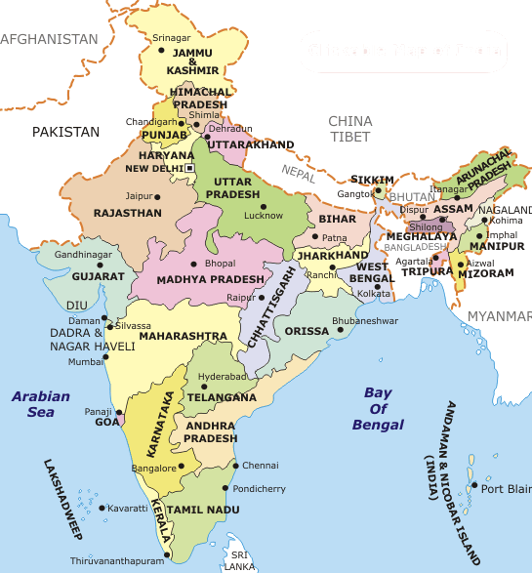
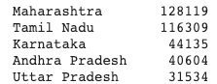
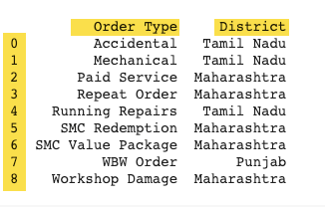
Problem Statement 2 - Geography Business Overview
Number of orders generated by top Districts
Ranking of Districts by Order Type orders.
Notes:
Can we include some examples here?

Slide 6
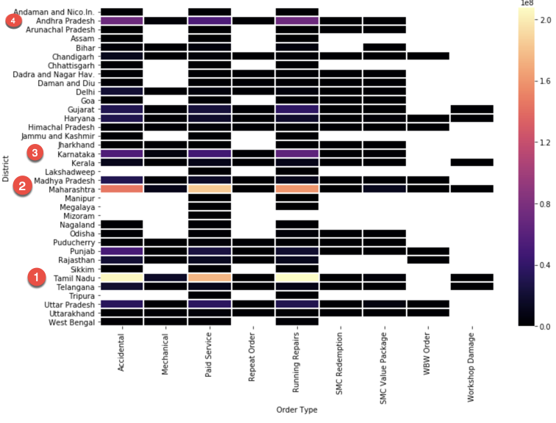
HeatMap Visualization
HeatMap allows us to visualize and rank the top Districts in terms of Revenue as follow:
Tamil Nadu
Maharashtra
Kamataka
Andhra Pradesh
Notes:
Can we include some examples here?

Slide 7
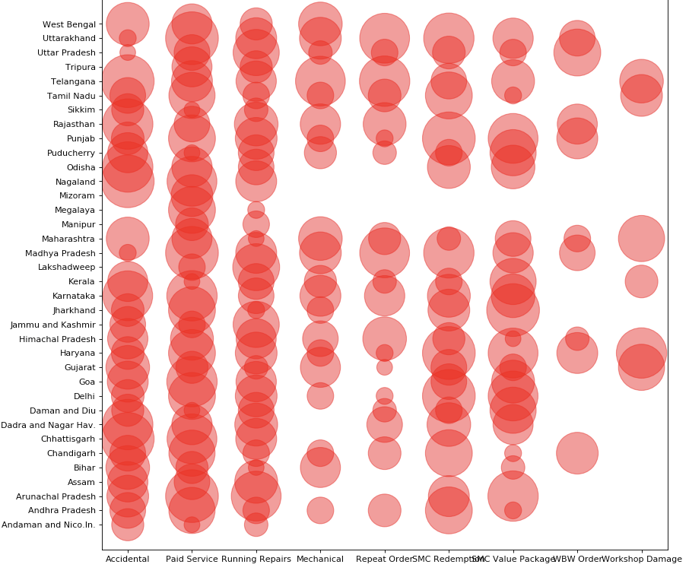
-Accidental, Paid Services and Running repairs ranks as the top order types across all Districts.
-Most of the Districts cover the majority of the business units expect a few ones as seen in the chart (Mizoram, Megalaya & Manipur).
-Business vertical such as “Workshop Damage” has the fewer participation among al Districts.
Notes:
Can we include some examples here?

Slide 8
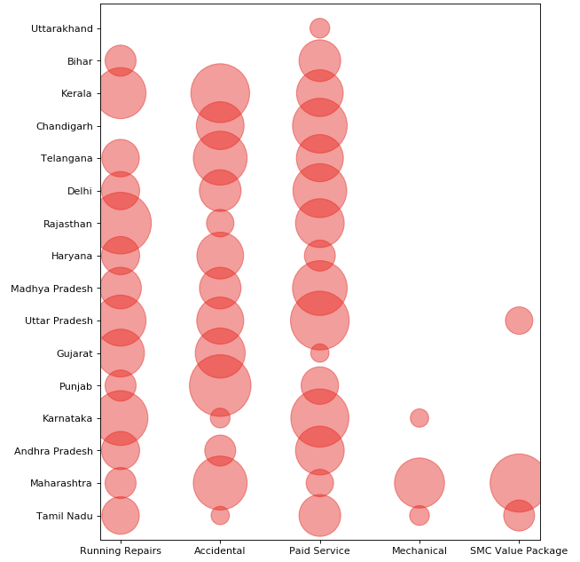
A Closer look to top Districts driving revenue to the overall business by top Order Types.
Notes:
capstone_v1_a.ipynb

Slide 9
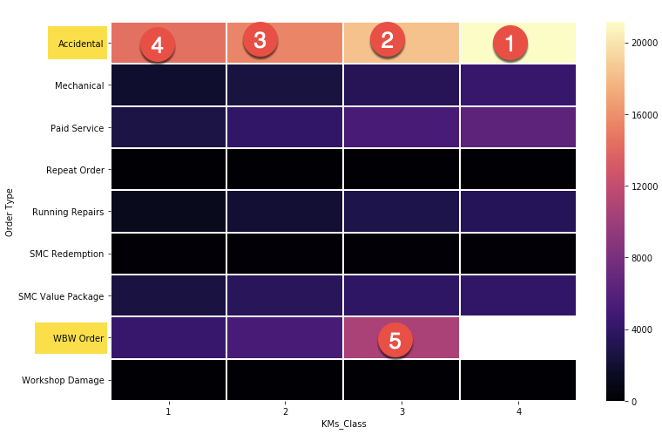
Car Class breakdown by Mileage driven
 | Km Driven | % Car count
Class 1 | < 20k | 12%
Class 2 | 20k < 60k | 38%
Class 3 | 60k < 100k | 28%
Class 4 | > 100k | 22%
Revenue from “Accidental” order type is not only high across all Km_Class but also gradually increases as more mileage is driven.
Notes:
Source notebook: ts_v3

Slide 10
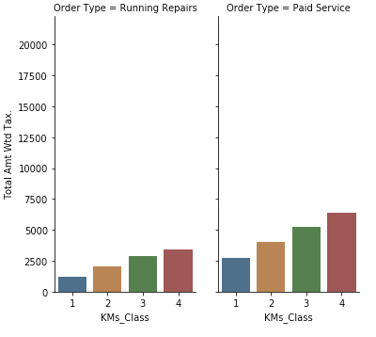
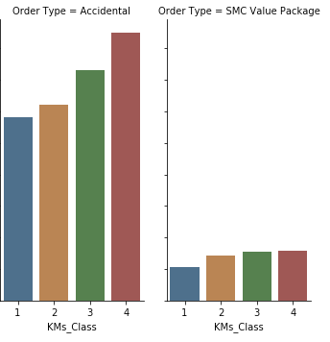
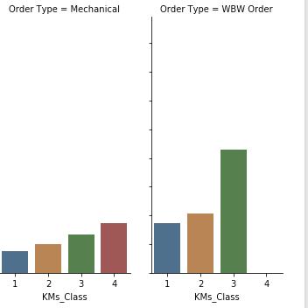
Car Class and Order Type Overview
For those retail cars, there is a strong correlation between the older the car, the more revenue generated by the business, as Class 4 (>100k driven) is mainly the highest revenue driver across all categories as seen below.
Notes:
Source notebook: ts_v3

Slide 11
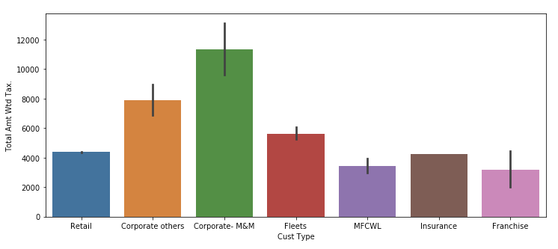
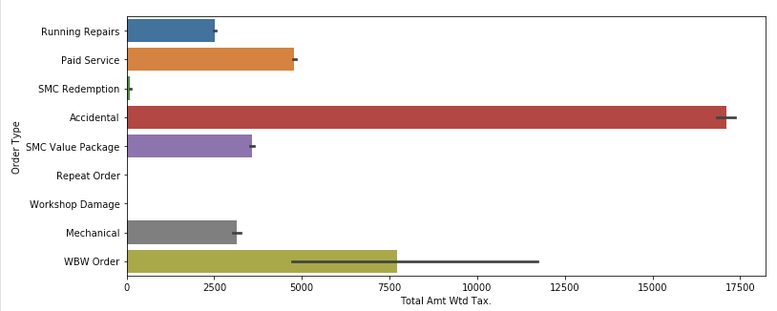
Order Type and Customer Type Overview
-Although “Corporate M&M” Customer type is the main revenue source, it only accounts for less than 1% of the total number of transaction generated while “Retail” type accounts for 99% of total transactions.
-While the largest order type bucket in terms of sales volume is Accidental, “Paid Services” accounts for 54% of total transactions.
Notes:
Source notebook: ts_v3

Slide 12
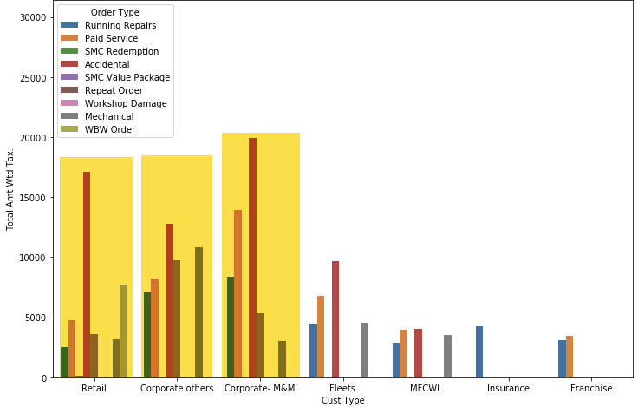
Order Type and Customer Type Overview
-”Accidental” order type seems to be a strong vertical across all unit businesses.
-“Paid Services” is a strong niche from Corporate.
-”Mechanical” type is a solid revenue source for Retail customers.
Notes:
Source notebook: ts_v3

Slide 13
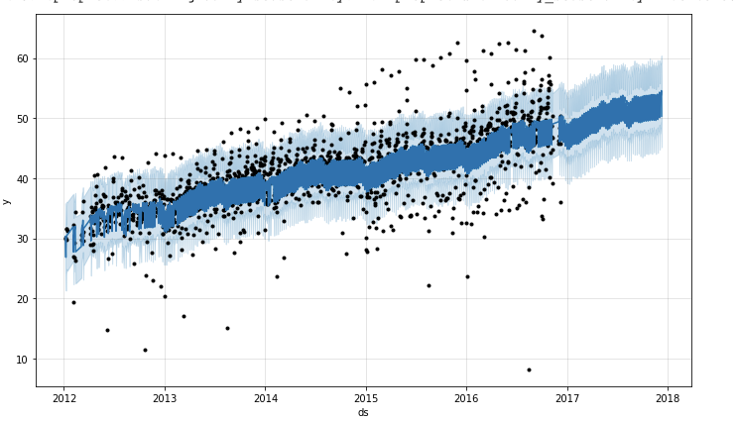
Revenue Forecast - Times Series Analysis with Prophet
-Daily Forecast revenue
-Prophet library
-Forecast periods=365
-BoxCox transformation
Notes:
Can we include some examples here?

Slide 14
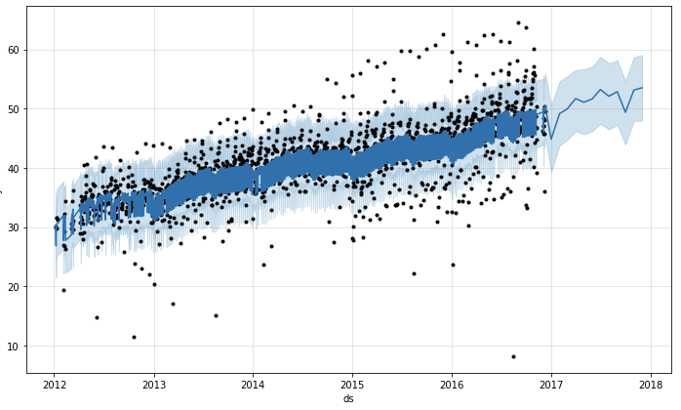
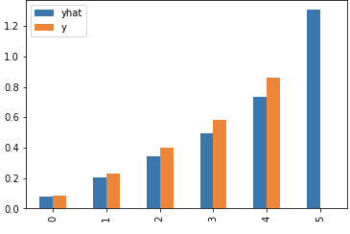
Revenue Forecast - Times Series Analysis with Prophet
-Monthly Forecast revenue
-Evaluation Model - RMSE = 1.3mm.
-Future revenue for the upcoming year is projected to increase by 70%.
Notes:
Can we include some examples here?

Slide 15
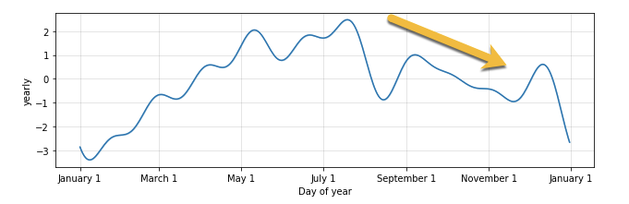
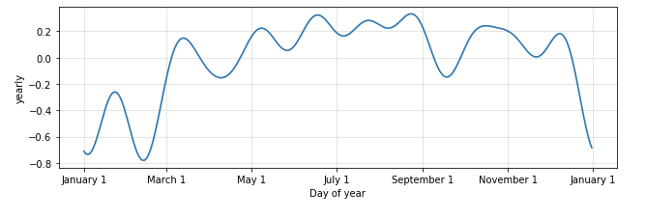
Stationary Processes with Time Series
Our Seasonality analysis approach was divided between Non-Accidental and Accidental type as we believe accidents in general are less likely to be correlated with time than other order types such as Running Repairs and Paid Services..
The first chart corresponds to all order types (excluding Accidental) and shows a stronger Non-Stationary effect than that of Accidents.
It appears that it business peak is within July & August and it trends down as seen in first chart.
Non-Accidental vs Accidental order type
Notes:
Source ts_v5 notebooks acc and non_acc

Slide 16
Market Segmentation Approach
RFM Score Calculations
RECENCY (R): Days since last purchase
FREQUENCY (F): Total number of purchases
MONETARY VALUE (M): Total money this customer spent

Slide 17
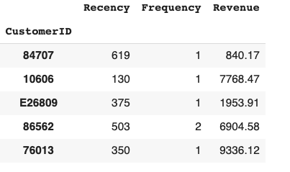
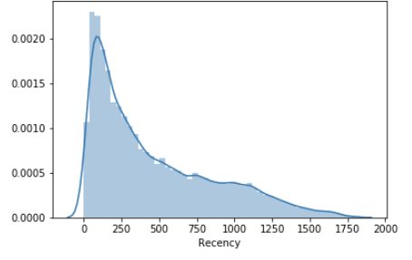
RFM Calculation: Recency, Frequency and Revenue.

Slide 18
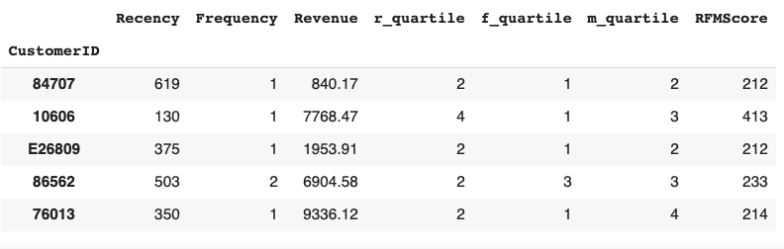
RFM Score: Four Segments using Quartiles
RFMScore = concatenation of R, F and R values.
Split metrics into segments is by using quartiles 25, 50, 75.
The lowest recency, highest frequency and monetary amounts are our best customers.

Slide 19
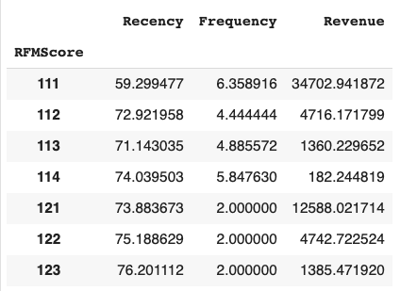
Average - RFM Customer Segmentation
The Scoring index has 48 combinations between 111 and 444.
The average highest RFM score has a recency of 59 days since last visit, 6 visits to the shop in total and $34,702 revenue generated.

Slide 20
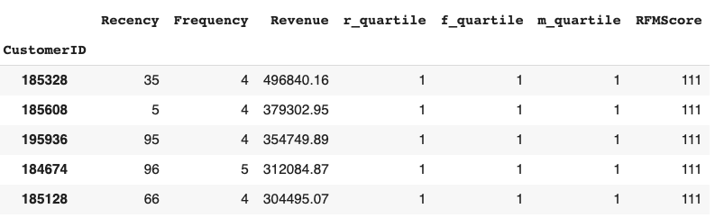
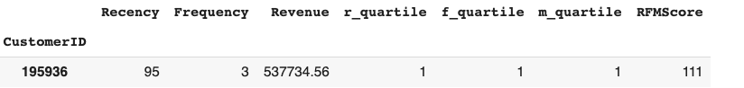
Who are the top of our best customers?
User story: Customer ‘125936”has visited the business 95 days ago, three times in total and generated $537k to the business. This makes her a very high value customer with perfect score “111”.

Slide 21
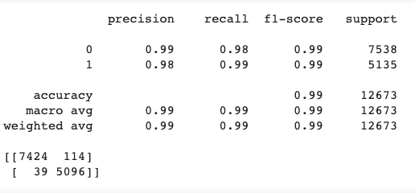
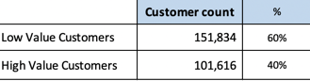
Customer LTV - Using Quartile Clusters and Logistic Regression: Accuracy: 98.7%
Binary Classification Model. High / Low Value index score.
Threshold Index score: X > 223: High Value Customers, else, Low Value Customers.

Slide 22
Customer LTV - Using Quartile Clusters
Model Fine tuning: Cross Validation & Logistic Regression
We applied a Cross Validation technique to better regularize and optimize bias and Overfitting; the Accuracy validation of the model comes down to 95,7%.

Slide 23
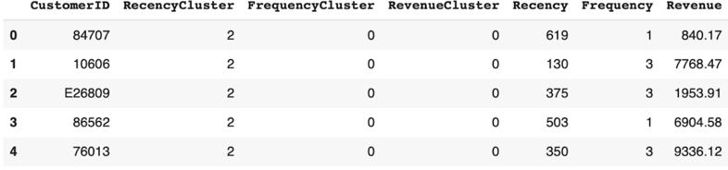
RFM: Another Segmentation approach using K-Means clustering
This RFM scoring model identifies our high value customers from the others.
Using K-means clustering, we divided our data into 5 clusters for recency, frequency and monetary using Recency value, Frequency of visit to workshop and Revenue that particular customer has generated.
Higher the value of any cluster, more valuable is the customer

Slide 24
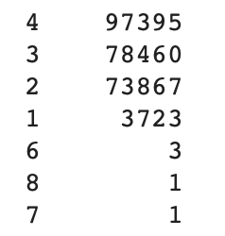
Average - RFM Customer Segmentation
OverallScore = RecencyCluster + FrequencyCluster + RevenueCluster.
OverallScore has eight different combinations.
As per the score it was observed that some customers who have better recency/ frequency has low revenue generation value.
Thus we got only 8 possible combination.
Customers with overall score> 4 are very few

Slide 25
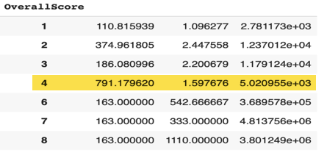
From this table we have concluded that the customers with overall score as 4 are actually most valuable to the company.
Customers > 4 are outliers but they are generating huge revenue for the company.

Slide 26
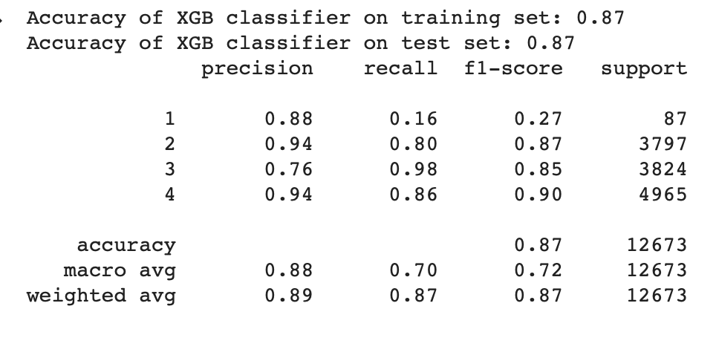
Predictiving our Customer LTV - Using K-Means Clusters and XGBoost: Accuracy: 88%
ML library called XGBoost to do the classification uses a multi classification model
(Customer with overall score > 4 were very few , thus not included in the test set)

Slide 27
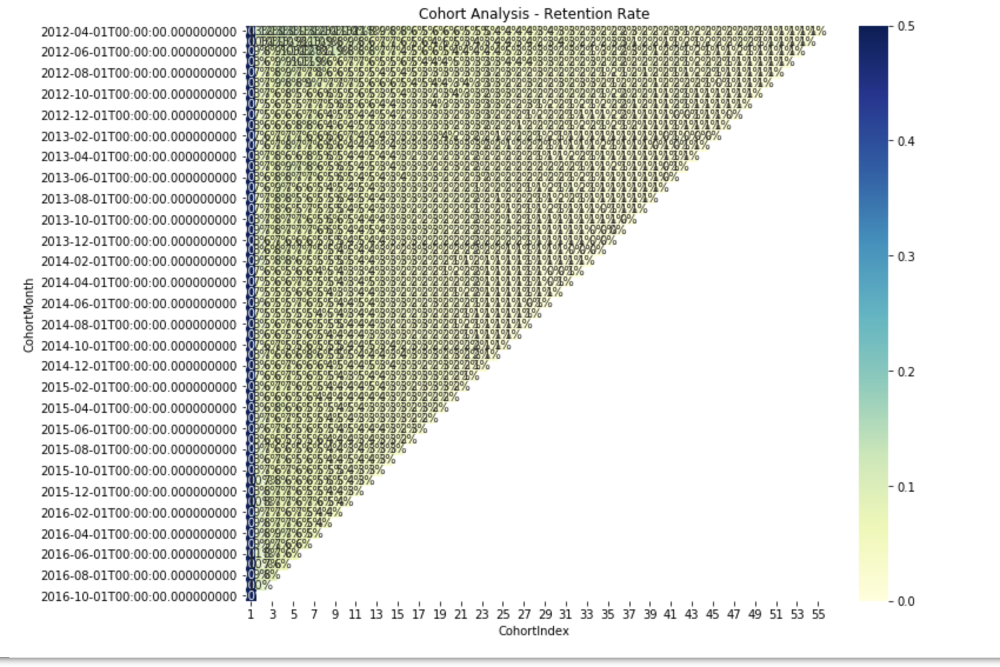
Cohort Analysis
We have used Cohort Analysis to study customer behaviour in terms of retention and revenue generation.
Retention: We made the Cohort with respect to customer visit such that if customer has visited the workshop in a particular month, what is his chance to visit in the subsequent months. Using this, we have mapped the retention percentage of the customers.
As per this heatmap, we can say that retention was better initially but it has reduced with time.

Slide 28
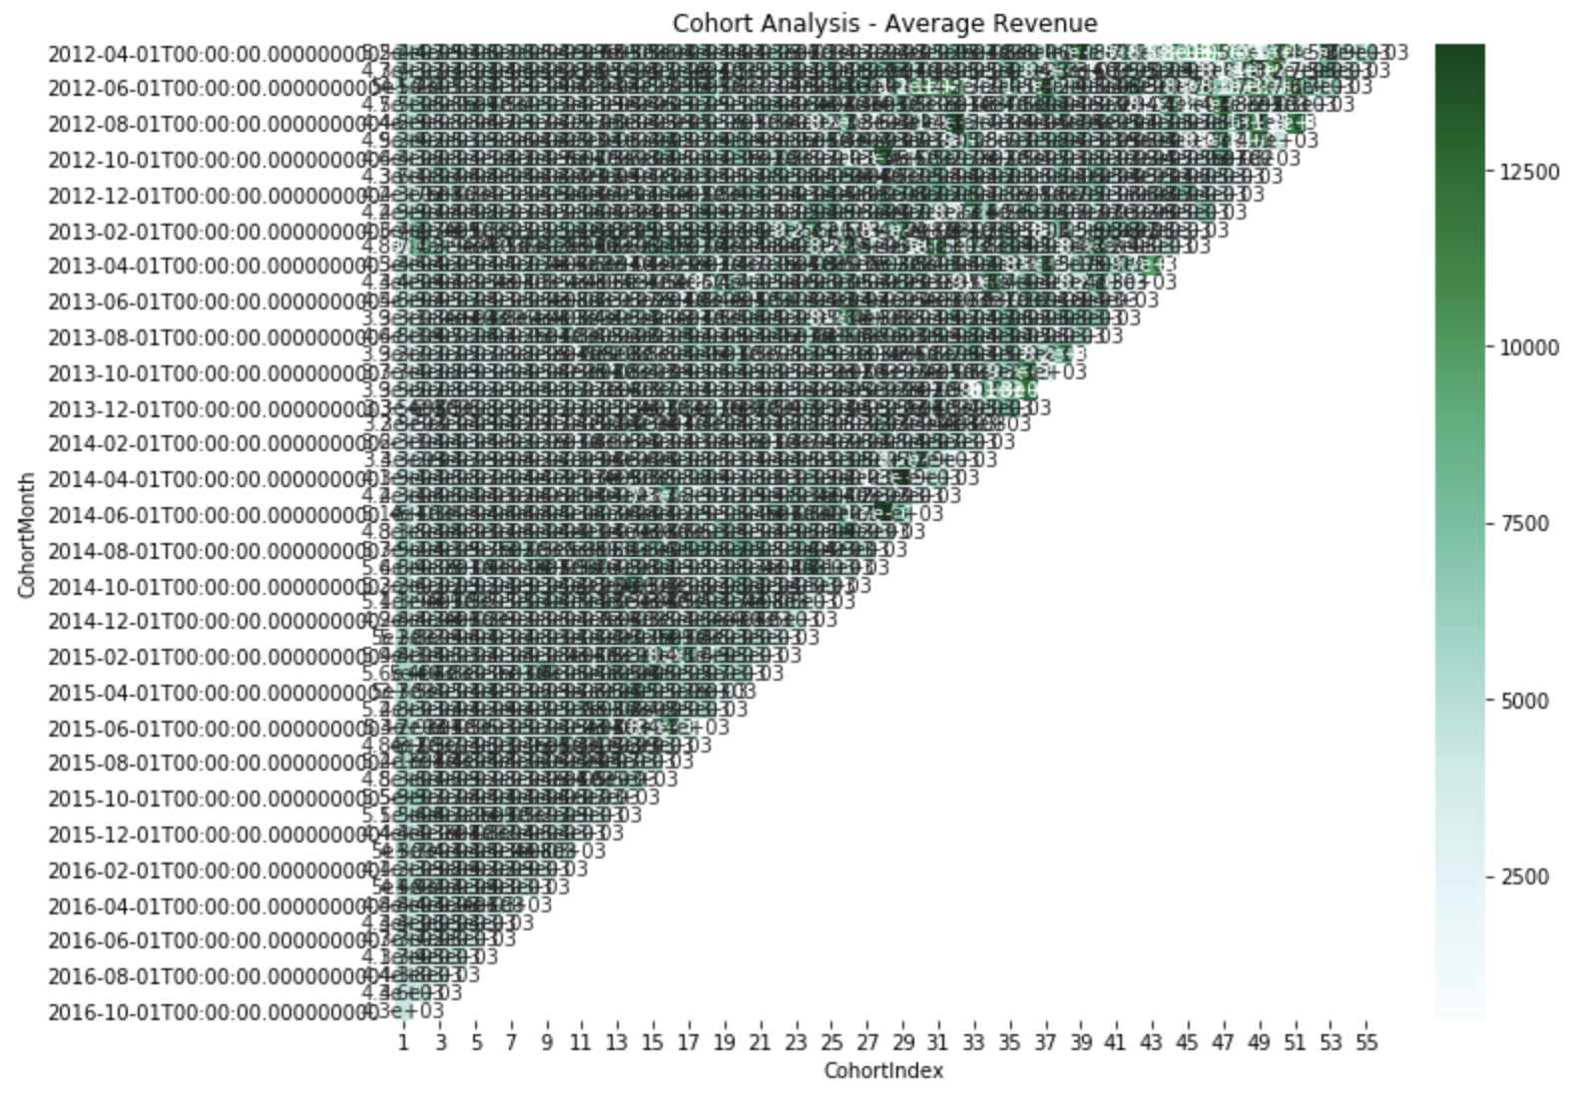
Cohort Analysis
Revenue: On similar terms as retention, we have also generated cohort heat map for revenue.
As per this heatmap, it was observed that retained customers are generating more revenue in their later visits.

Slide 29
Next Steps
If you had more time, what more would you have done?
We will definitely keep working on improving the project. Here below are a good ideas and enhancements to make this a better project
We would like to do more cohort analysis using more features to get deep insight of customer behaviour.
During profit calculation, we realised that cost is not provided in the dataset. Hence we would like to improve the dataset and incorporate profit calculation in the analysis.

Slide 30
References
https://towardsdatascience.com/tagged/data-driven-growth
https://towardsdatascience.com/data-driven-growth-with-python-part-3-customer-lifetime-value-prediction-6017802f2e0f
https://towardsdatascience.com/data-driven-growth-with-python-part-2-customer-segmentation-5c019d150444

Slide 31
Things to Remember
Max 20 slides for the entire team
Time: 10 mins for the team.
Each team member must talk about what they did in the process
Put bullet points and pictures. (No code)
Think of it as a short pitch to the stakeholder.

